Slide 1
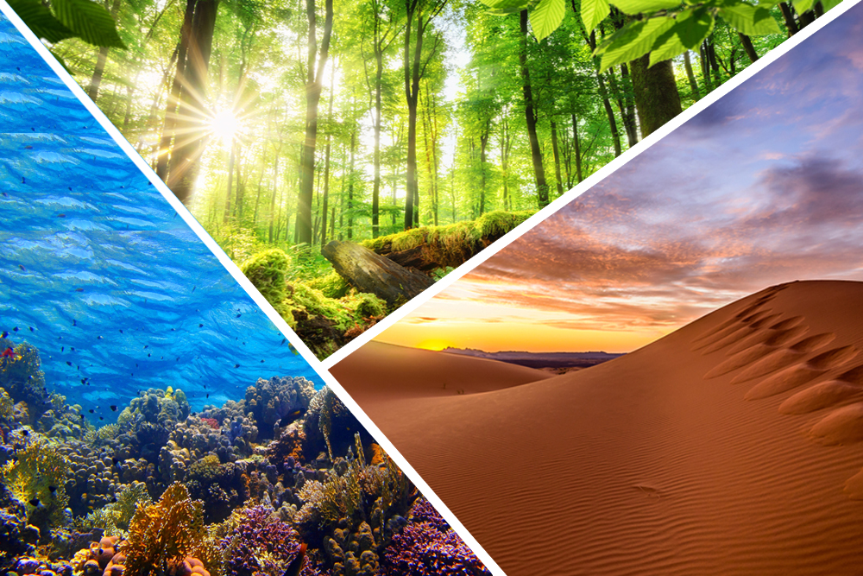
What is an ECOSYSTEM ?

Slide 2
The ecosystem is the structural and functional unit of ecology where the living organisms interact with each other and the surrounding environment.

Slide 3
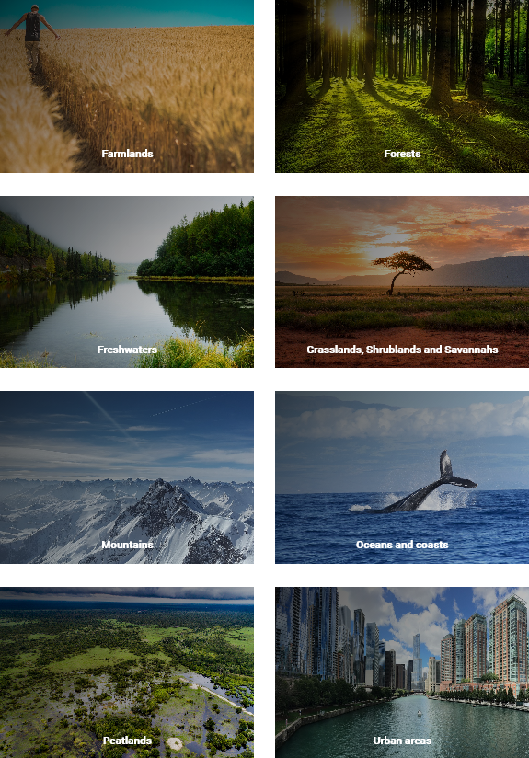
Basic Types of Ecosystems
Note : There are various other types of
ecosystems, some of which has not
even been discovered yet.

Slide 4
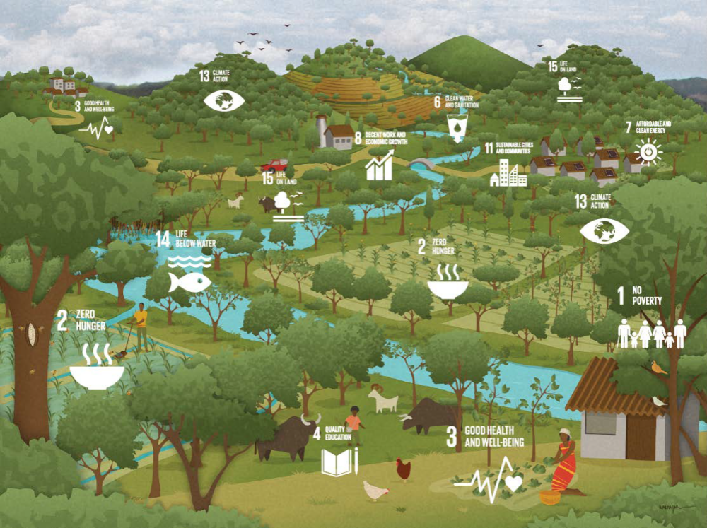
How is a Better Ecosystem better for us ?

Slide 5
Healthy ecosystems clean our water, purify our air, maintain our soil, regulate the climate, recycle nutrients and provide us with food.
They provide raw materials and resources for medicines and other purposes.
They are at the foundation of all civilization and sustain our economies.
It's that simple: we could not live without these “ecosystem services”. They are what we call our natural capital.

Slide 6
How is the Ecosystem being Affected ?
Pollution
Increase in Population
Resource Exploitation
Land Clearing
Climate Change

Slide 7
Some Other Reasons but not the last ones
The loss of ecosystems is caused mainly by changes in land and sea use, exploitation, climate change, pollution and the introduction of invasive species.
Some things have a direct impact on nature, like the dumping of waste into the ocean.
Other causes are indirect. Those include demographic, economic, political and institutional arrangements underpinned by social values, and they interact with one another.

Slide 8
What is ECOSYSTEM RESTORATION ?

Slide 9
Ecosystem restoration means assisting in the recovery of
ecosystems that have been degraded or destroyed,
as well as conserving the ecosystems that are still intact.

Slide 10
How do we contribute to Ecosystem Restoration ?

Slide 11
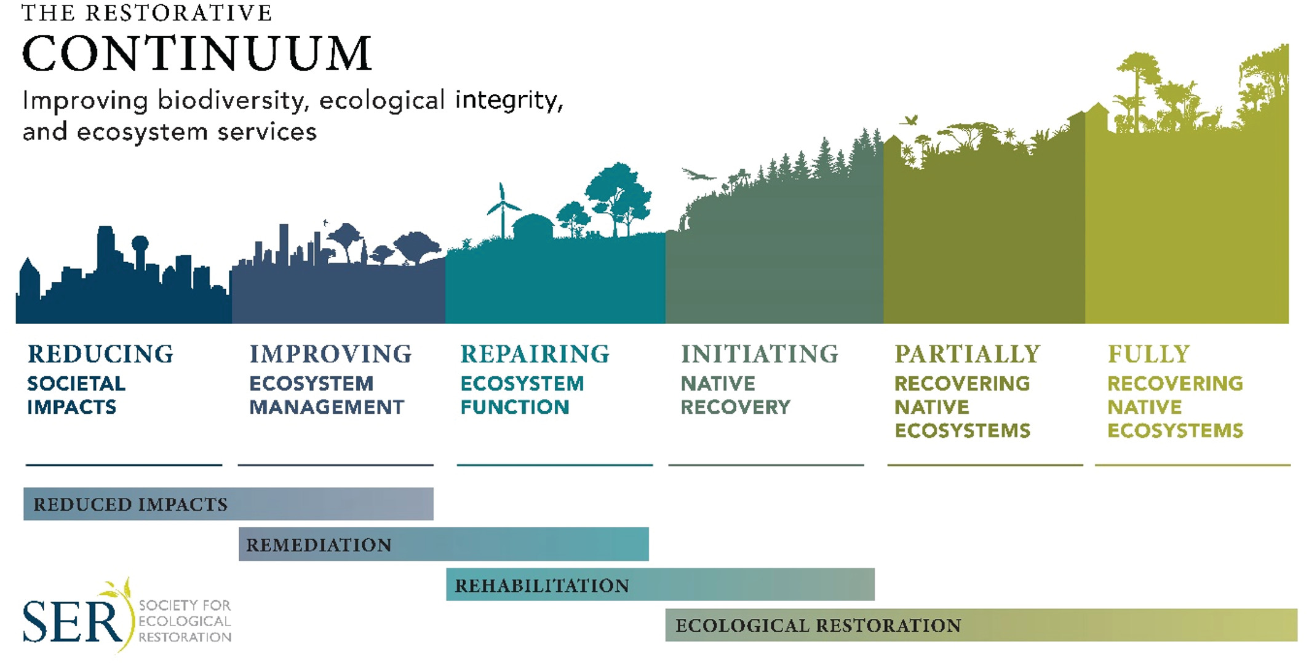
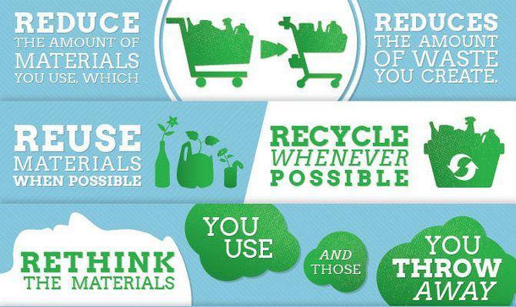

Slide 12
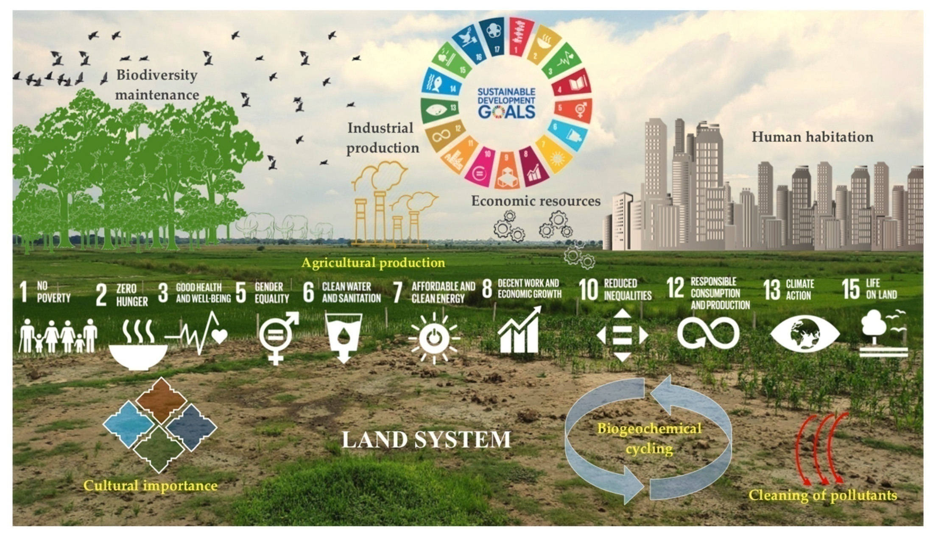

Slide 13
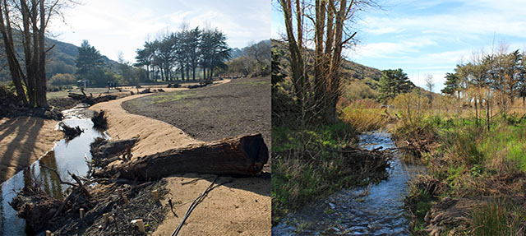
How every person can help ?
From This
To This
Rely on 3R rule to every material before throwing away
Reduce the reuse of non-biodegradable materials such as plastics which take long time to decompose which cause harm to the environment
Plant some plants or trees as it will undoubtedly help in the long run
Keep your surroundings clean and dispose non-biodegradable materials properly

Slide 14


Slide 15

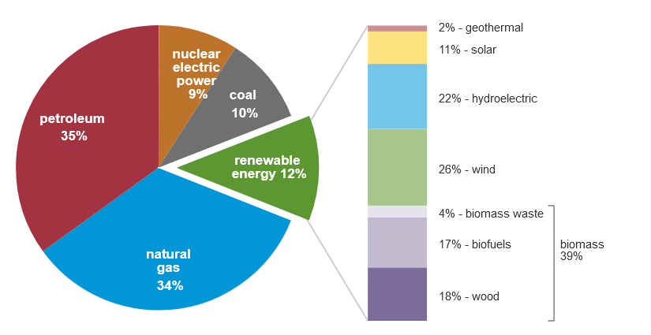
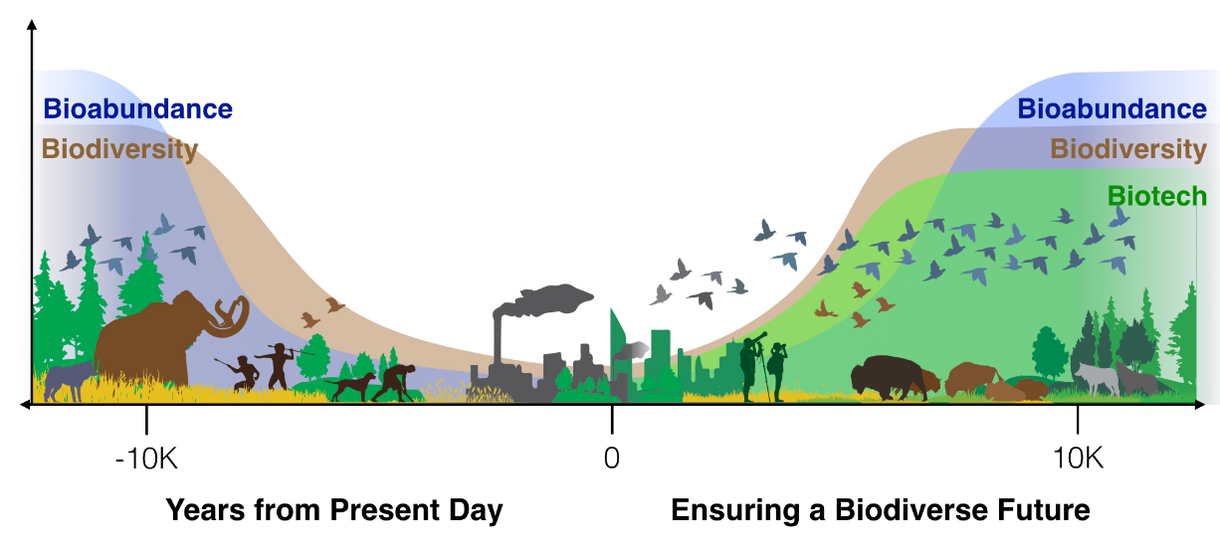
How Technology has Helped us ?
Developing renewable energy technology
Saving endangered wildlife
Adopting a smarter lifestyle

Slide 16
Other Ways Technology helps us in Restoring the ecosystem
Saving Energy
Conserving Resources
Eliminating Waste
Making Us Smarter

Slide 17
Conclusion

Slide 18
Resources used for Educational Purposes from :-
https://www.iucn.org/commissions/commission-ecosystem-management/our-work/cems-thematic-groups/restoration
https://ec.europa.eu/environment/nature/biodiversity/intro/index_en.htm
https://sciencing.com/how-do-plants-animals-depend-on-each-other-13428072.html
https://byjus.com/biology/ecosystem/
https://www.scienceabc.com/nature/what-are-ecosystem-services.html
https://www.decadeonrestoration.org/what-ecosystem-restoration
https://onlinelibrary.wiley.com/doi/10.1111/rec.13035
https://www.allerin.com/blog/3-ways-technologies-are-helping-us-save-the-environment

Slide 19
Prepared/Presented by Tejeshwar Pradhan
Siliguri Institute of Technology (SIT)
MCA(L) - 6th Semester
Roll : 33601019029
Email : tejeshwarpradhan22@gmail.com

